Slide 1
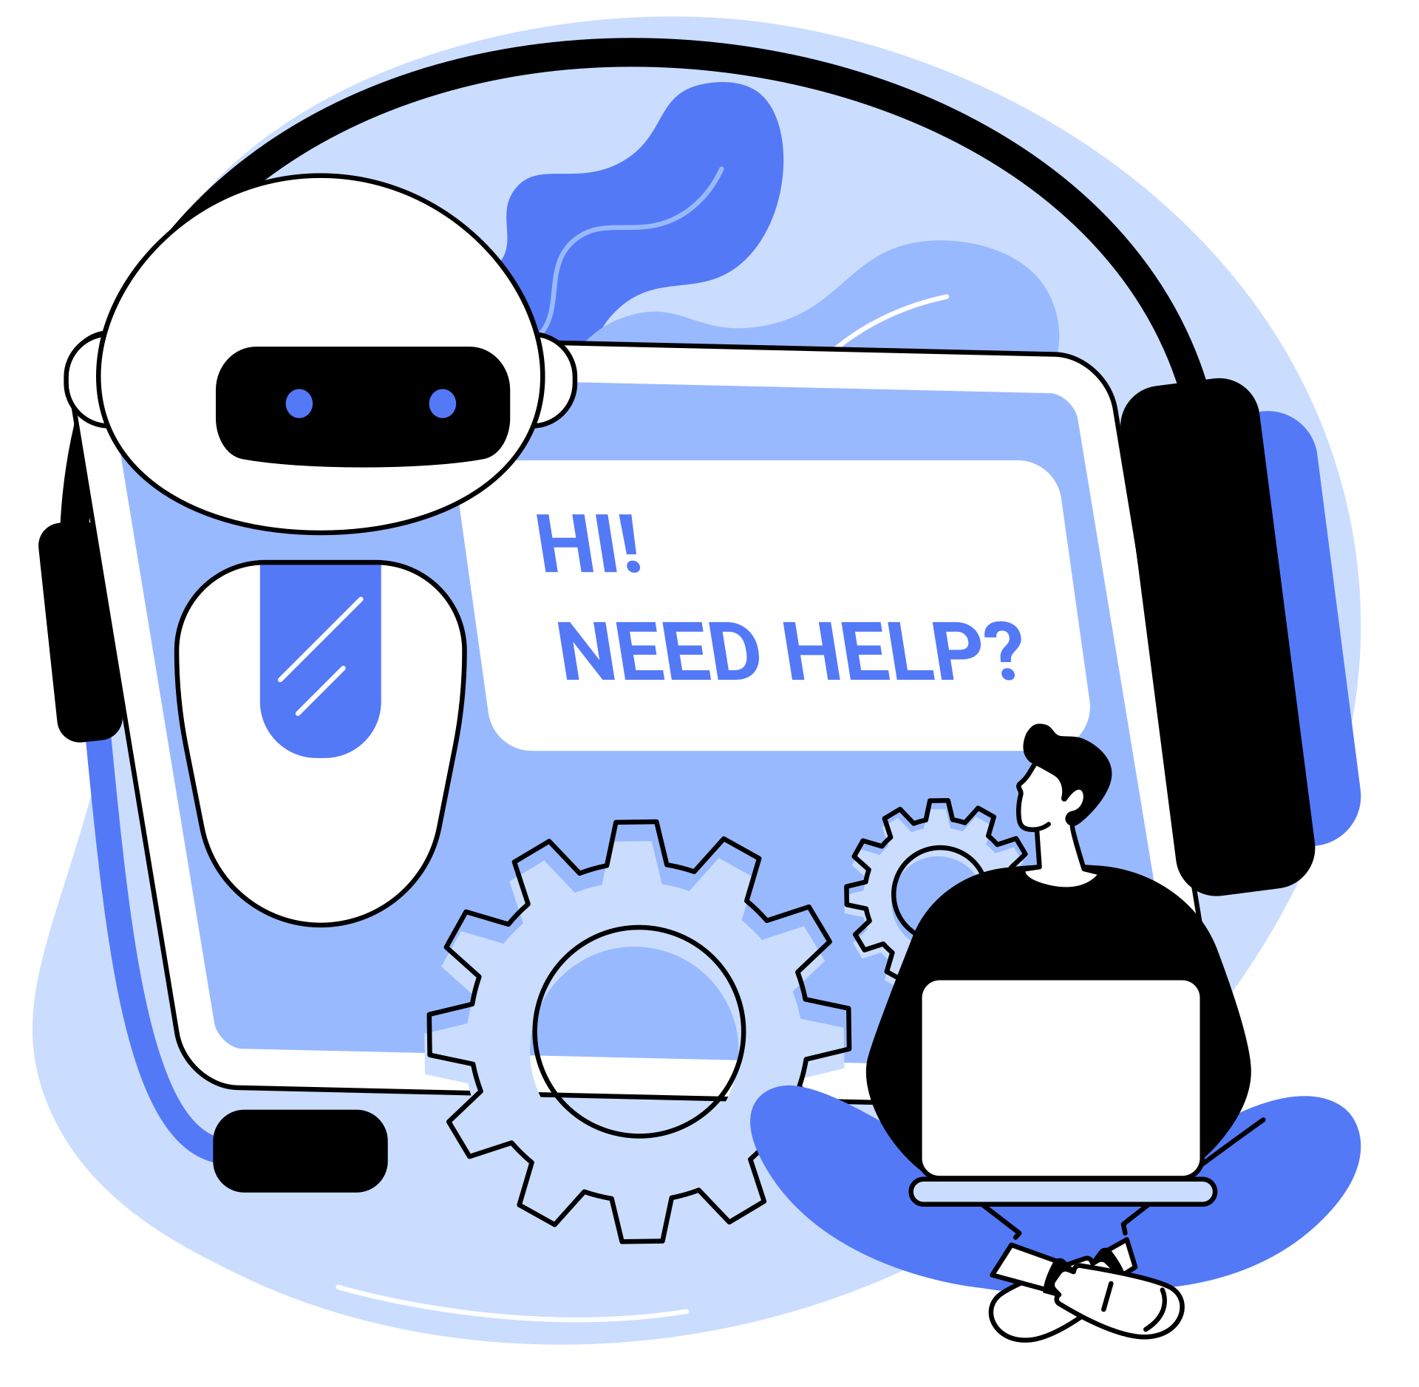
ARTIFICIAL
INTELLIGENCE
TECHNOLOGY

Slide 2
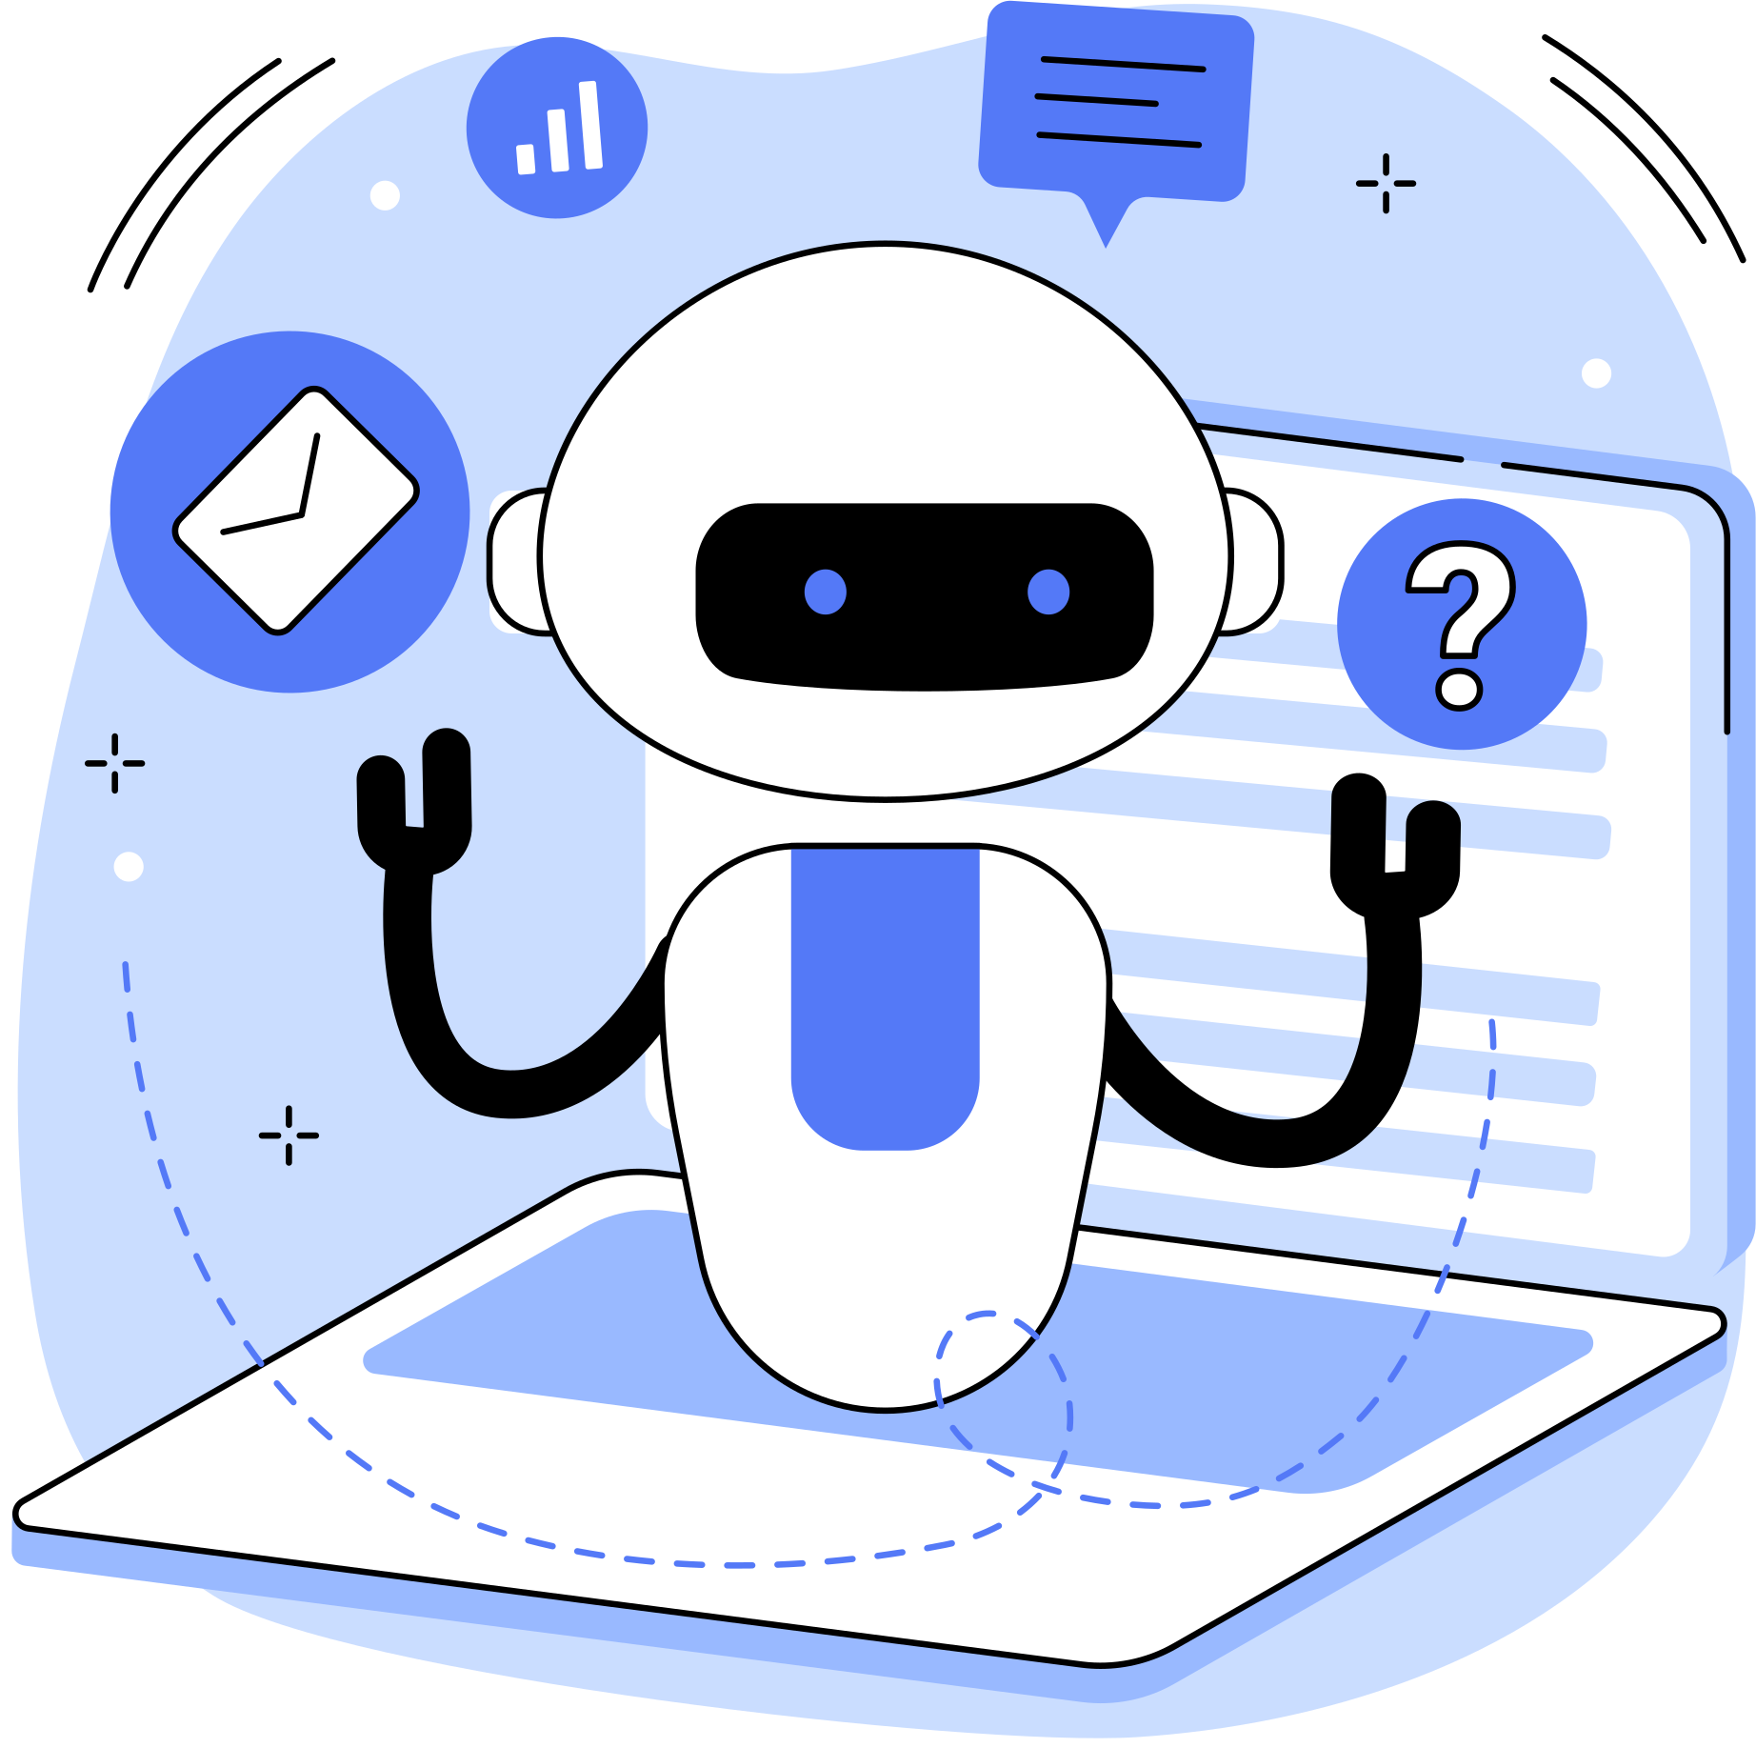
What is Artificial Intelligence?
Artificial intelligence is a technology that builds and enables machines or non-human entities to perform tasks that are the core characteristics of human beings.

Slide 3
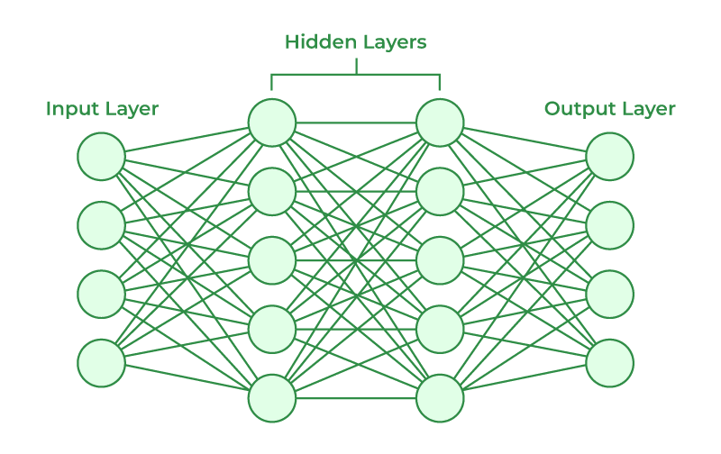
WHAT is neural network
Neural network is a network of neurons connected with each other. In artificial intelligence, it is referred to as Artificial Neural Network (ANN) or Simulated Neural Network (SNN)

Slide 4
Major Approaches Used in Artificial Intelligence Research
Symbolic
Connectionist Approach
Symbolic approach is also referred to as Symbolic Artificial Intelligence, precisely SAI.
The symbolic approach is based on the notion that the whole world can be taught to the machines through the input of symbols used to denote an entity in the world.
Connectionist approach of artificial intelligence research is also known as Numeric Artificial Neural Networks, precisely referred to as NANN.
According to this approach, the artificial intelligence can be developed through a large network of processors that work like neurons in a human mind to process the signals coming from multiple input sources

Slide 5
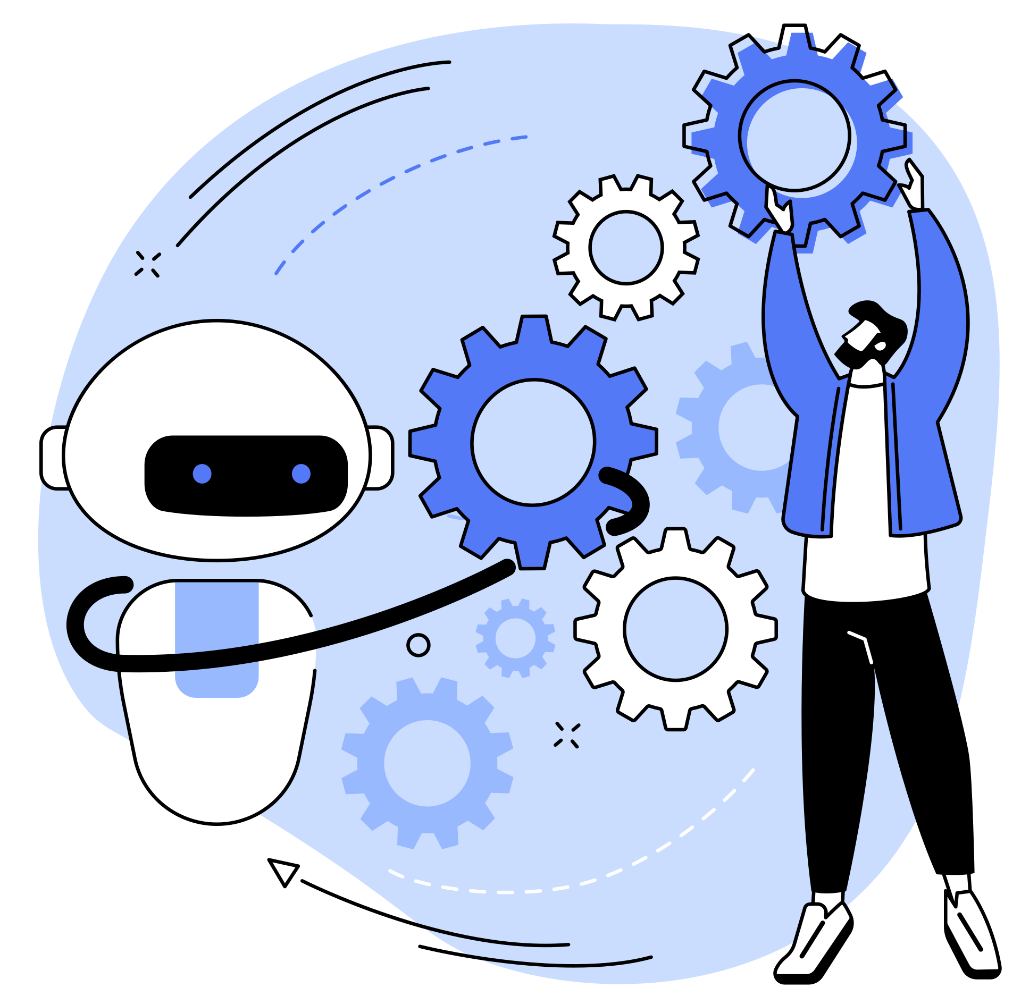
objectives of ai
Reasoning
Knowledge Representation
Problem Solving
Motion and Manipulation
Natural Language Processing
Artificial General Intelligence
Learning
Social Intelligence
Planning
Business Intelligence
Machine Perception

Slide 6
AI ERA TIMELINE
1943—Artificial neuron evolution
1950—Development of Turing Machine
1956—Official birth of AI domain via Dartmouth Conference
1966—Development of ELIZA, the first chatbot
1972—First intelligence robot WABOT-I was invented
1972–80—Downslide of artificial intelligence referred to as AI Winter-I.
1980—Development of Expert System
1987–93—Another downslide of AI known as AI Winter-II
1997—Invention of IBM Deep Blue, which beat the world champion in chess game first time.
2002—Invention of Roomba, the first for the home AI applications
2011—IBM Watson wins the quiz competition show first-time
2012—Development of Google Now
2014—Invention of Eugene Goostman chatbot, which passed the Turing test first time.
2015—Development of Amazon Echo
2020—Embodied Moxie, a robot companion for children.

Slide 7
MAIN AREAS OF AI APPLICATION
Natural Language Processing
Speech Recognition
Computer Vision
Expert Systems
Voice Recognition
Robotics
Text Recognition
Chatbot
Voice-to-Text Conversion

Slide 8
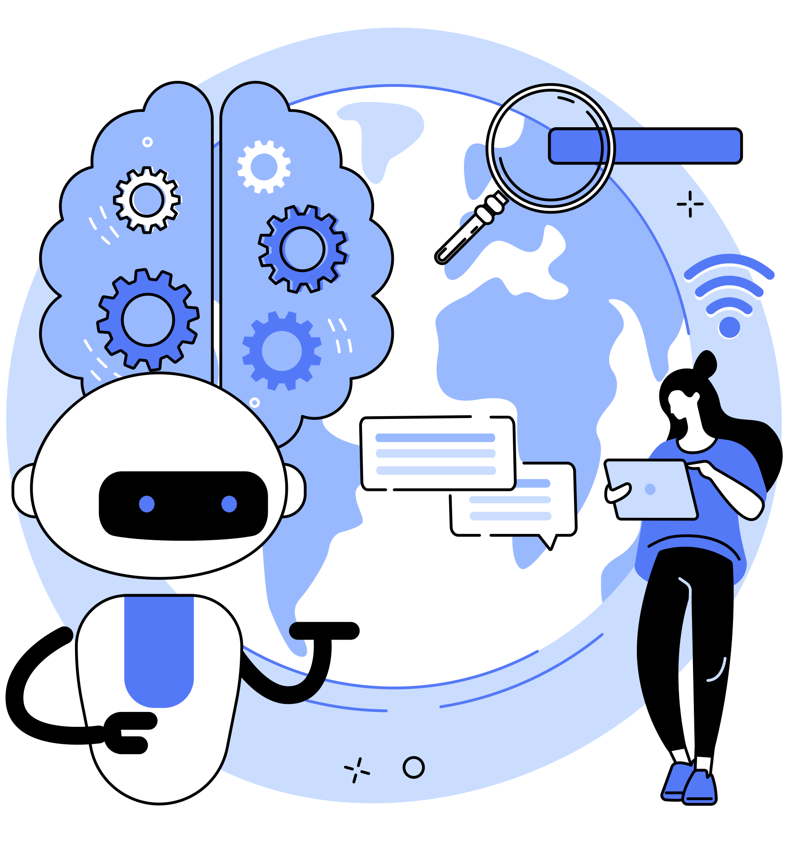
1
Reactive Machines
TYPES OF AI
2
Limited Memory
3
Theory of Mind
4
Self-Awareness
5
Artificial Narrow Intelligence (ANI)
6
Artificial General Intelligence (AGI)
7
Artificial Super Intelligence (ASI)

Slide 9
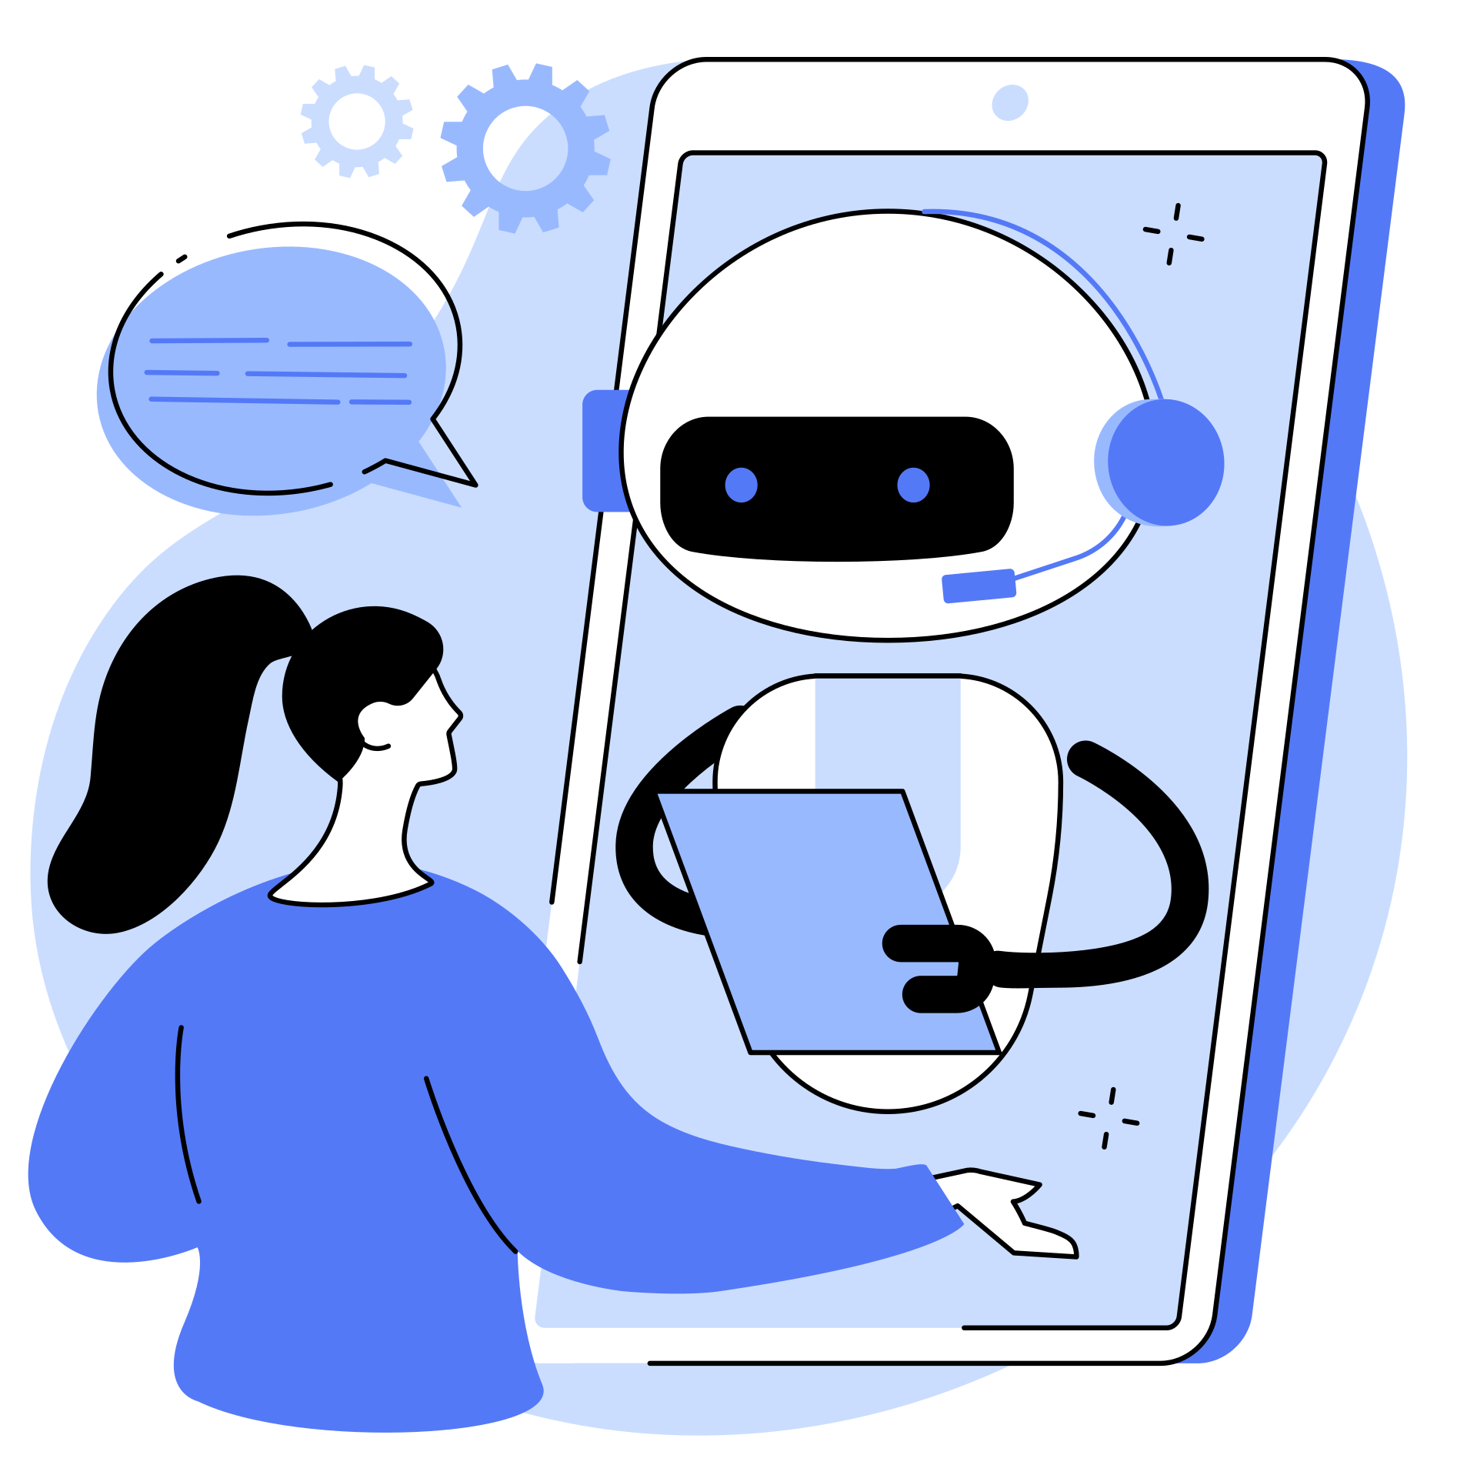
Intelligent (or, Intelligence) Agent (IA)
Intelligent Agent is an entity in an artificial intelligence that acts as decision maker through perception function by taking input from the environment through a sensor and acts through actuators in the AI environment.

Slide 10
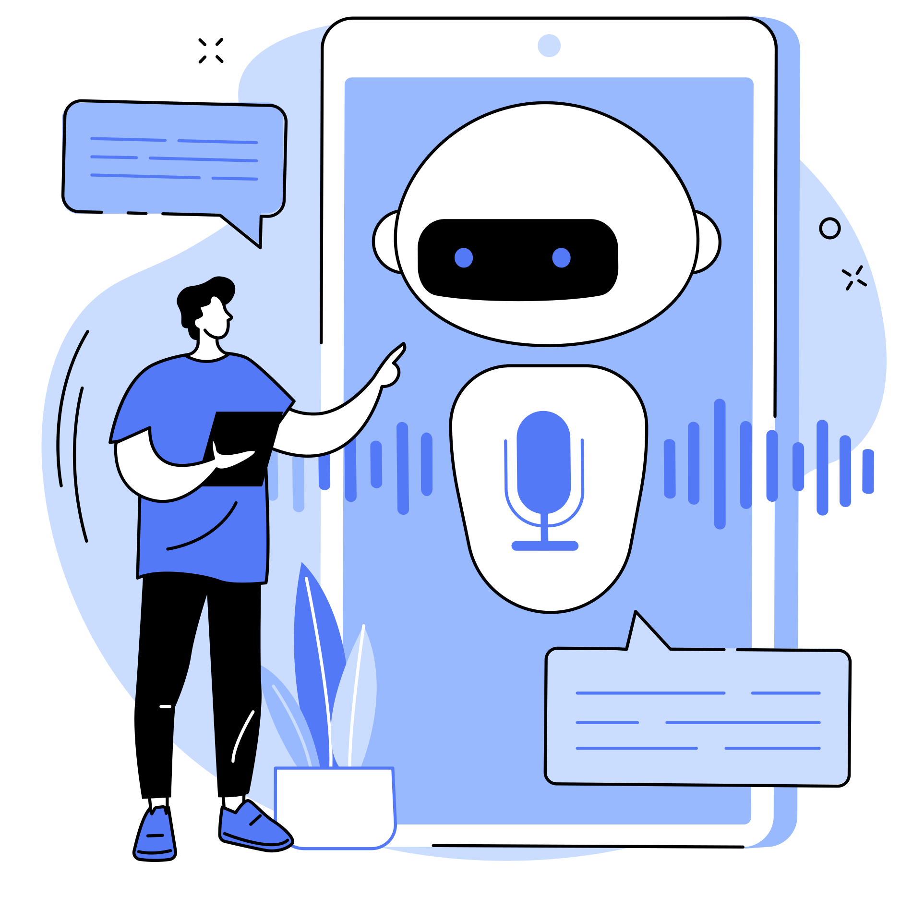
Artificial Intelligence Environments
An IA takes input from the environment for perceiving the situation of the environment through sensors and returns with an action on the environment based on the decision made through a range of action-based rules.

Slide 11
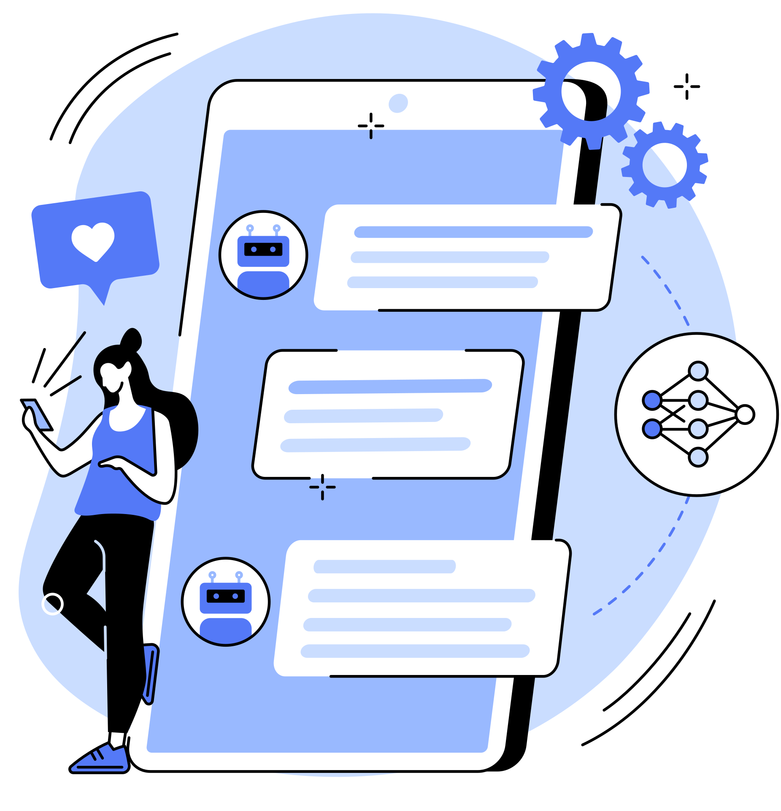
THANK YOU FOR LISTENING!

